Slide 1
19ECE301 Control Theory
5th Sem B.Tech ECE

Slide 2
Lesson overview
Introduction
Laplace transform review
The transfer function
Electrical network transfer functions
Translational mechanical system transfer functions

Slide 3
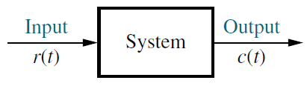
Introduction
After obtaining the schematic of the system next step is modelling
Modelling involves application of the corresponding physical laws like Kirchhoff's laws and newton’s laws
Differential equation is not a convenient tool
Transfer function is much more convenient as it gives a block representation of the system

Slide 4
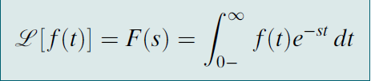
Laplace transform review
The block representation of the system can be achieved with the use of Transfer function which uses Laplace transform (remember signal processing 1)
Definition of Laplace transform (LT)

Slide 5
Laplace transform review
Derive the Laplace transform for the following time functions:
u(t),
e^{-αt}u(t)
tu(t),
sin ωt u(t)
cos ωt u(t)

Slide 6
Derive the Laplace transform of the unit step function. u(t)
Laplace transform review

Slide 7
Derive the Laplace transform of the exponential function
Laplace transform review

Slide 8
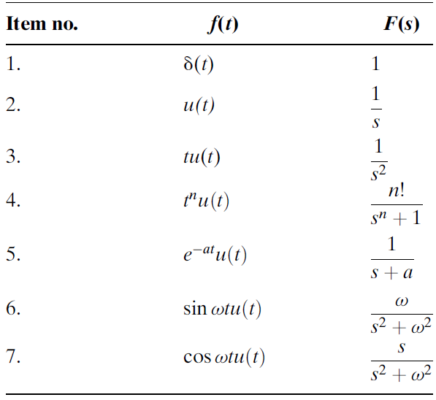
Laplace transform review
Laplace transform table

Slide 9
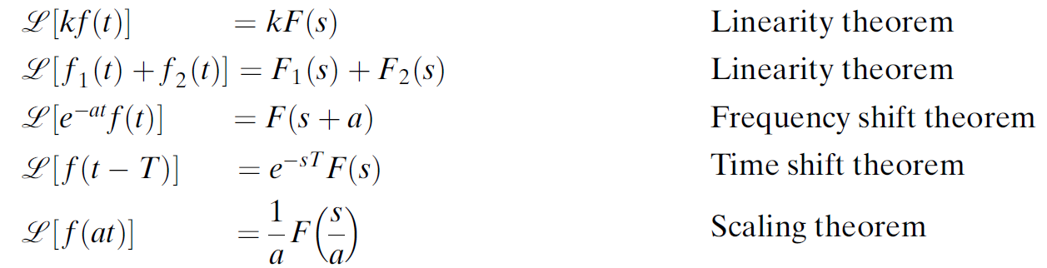
Laplace transform review
Laplace transform properties

Slide 10
Determine the Laplace transform for .
Laplace transform review

Slide 11
Laplace transform review
Determine the Laplace transform for .

Slide 12
Laplace transform review
Using the Laplace transform pairs Table and the Laplace transform theorems Table, derive the Laplace transforms for the following time functions:

Slide 13
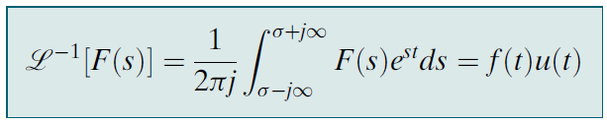
Laplace transform review
Now the inverse Laplace transform
Inverse Laplace Transform (ILT)Defined
Inverse Laplace transform can easily be computed by used the Laplace transform tables, properties and partial fractions

Slide 14
Determine the inverse transform of the function below.
Laplace transform review

Slide 15
Laplace transform review
Partial fraction expansion (to find ILT)
Case 1. Roots of the Denominator of F(s) Are Real and Distinct
Case 2. Roots of the Denominator of F(s) Are Real and Repeated
Case 3. Roots of the Denominator of F(s) Are Complex or Imaginary
Case 4. Roots of the Denominator of F(s) Are Complex or Imaginary and repeated

Slide 16
Determine the inverse transform of the function below.
Laplace transform review

Slide 17
Contd...
Laplace transform review

Slide 18
Laplace transform review
Determine the inverse transform of the function below.

Slide 19
Continue..

Slide 20
Laplace transform review
With knowledge of the above we can solve ordinary differential equations using Laplace transforms
Steps involved in solving ODE using the Laplace transform.

Slide 21
Laplace transform review
Given the following differential equation, solve for y(t) if all initial conditions are zero. Use the Laplace transform.

Slide 22
Laplace transform review
Given the following differential equation, solve for y(t) if all initial conditions are zero. Use the Laplace transform.
Sol.

Slide 23
Laplace transform review
Solve the following differential equation using Laplace transforms
Answer .

Slide 24
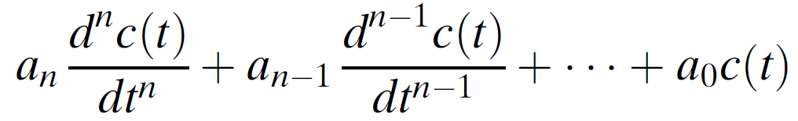
The transfer function
Having seen the above concepts let us see how to convert an differential equation to a transfer function
Consider a general n-th order, linear, time-invariant differential equation

Slide 25

The transfer function
Under the assumption that all initial conditions are zero the transfer function (TF) is the ratio of the output transform, C(s), divided by the input transform, R(s) is given by
Also, the output transform, C(s) can be written as
C(s) = R(s)G(s)

Slide 26

The transfer function
Question: Find the transfer function represented by assuming zero initial conditions.
find the response, c(t) to an input, r(t) =u(t), a unit step, assuming zero initial conditions.
Solution: Taking the Laplace transform of both sides, assuming zero initial conditions, we have:
The transfer function, G(s), is

Slide 27

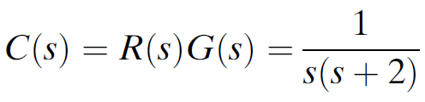
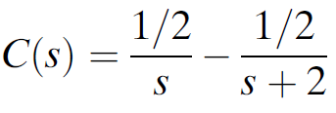
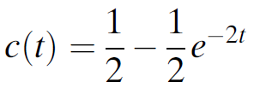
The transfer function

Slide 28
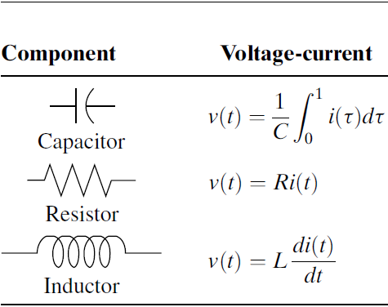
Electrical network transfer functions
We will consider only passive networks
As we know passive networks entirely consist of 3 basic elements R,L,C table below shows the relationships governing the quantities

Slide 29
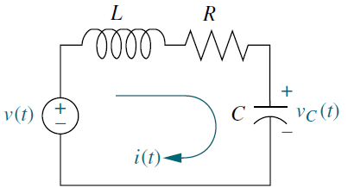
Electrical network transfer functions
We will apply Kirchhoff's laws obtain the diff equations and from them obtain the TF
Let us take an example (identify the input and output)

Slide 30
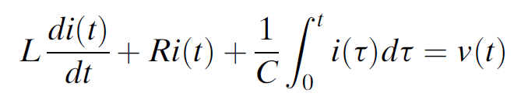
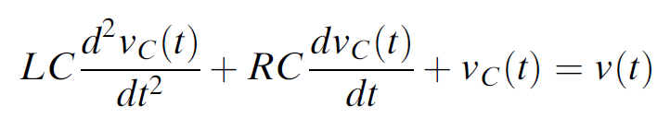
Electrical network transfer functions
Input is v(t) and the output is vc(t)
will apply Kirchhoff's laws obtain the diff equations and from them obtain the TF
Applying the KVL we get
Here the integro-differential equation relates input v(t) and i(t) output
We can rewrite the above equation with input v(t) and output vc(t)

Slide 31

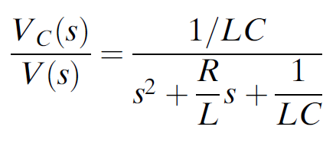
Electrical network transfer functions
Having obtained the desired differential equation we go for obtaining the transfer function which is obtained as

Slide 32
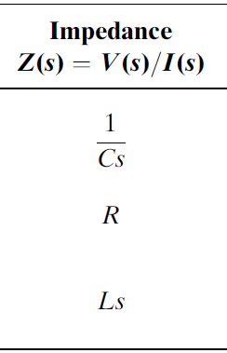
Electrical network transfer functions
Now let us apply the impedance trick to avoid differential and integral terms. By using the impedance concept

Slide 33
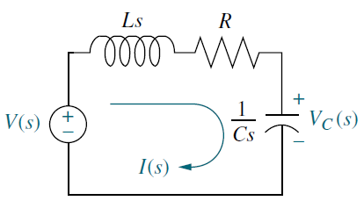
Electrical network transfer functions
Following are the steps for the impedance trick
1. Redraw the original network showing all time variables, as Laplace transforms.
2. Replace the component values with their impedance values.
Let us apply this to the previous problem

Slide 34
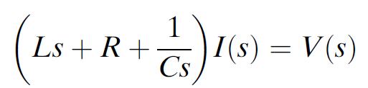
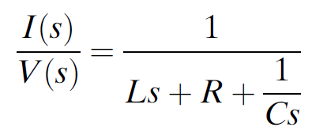

Electrical network transfer functions
Writing the KVL we get
Solving for I(s)/V(s),
But the output should be voltage across the capacitor
substituting this we get

Slide 35
Electrical network transfer functions
In case of complex circuits we apply the mesh analysis following are the steps.
1. Replace passive element values with their impedances.
2. Replace all sources and time variables with their Laplace transform.
3. Assume a transform current and a current direction in each mesh.
4. Write Kirchhoff’s voltage law around each mesh.
5. Solve the simultaneous equations for the output.
6. Form the transfer function.

Slide 36
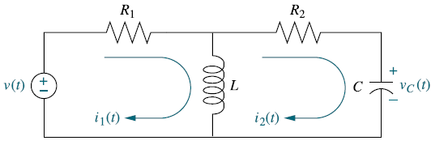
Electrical network transfer functions
Let us take an example. Find the transfer function I₂(s)/V(s)

Slide 37
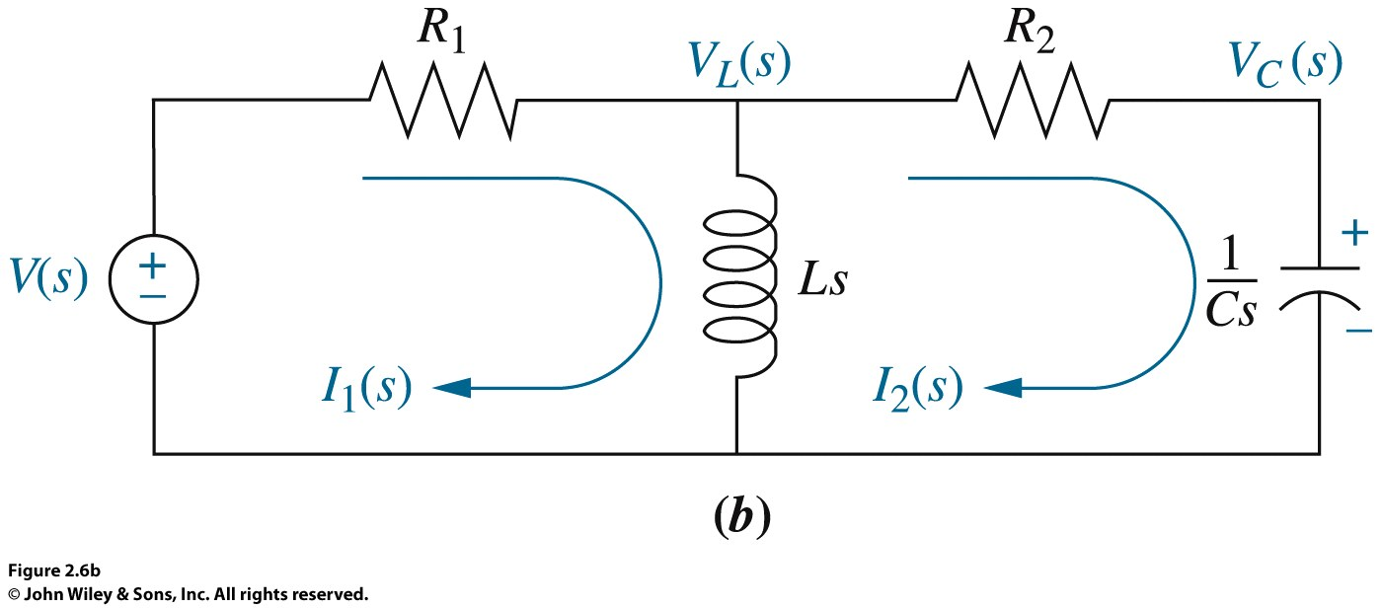
Electrical network transfer functions
Around Mesh 1, where I₁(s) flows
$R_{1}I_{1}(s) + LsI_{1}(s) − LsI_{2}(s) = V\{s)$ …………… (1)
Around Mesh 2, where I2(s)flows,
$LsI_{2}\left(s\right)+ R_{2}I_{2}\left(s\right)+\frac{1}{Cs}I_{2}(s) − LsI_{1}(s) = 0$ ………….. (2)

Slide 38
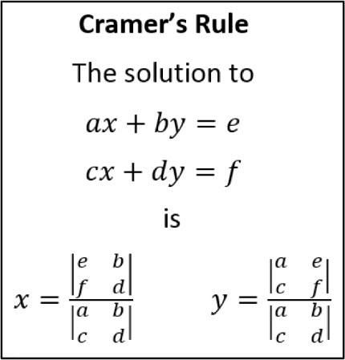
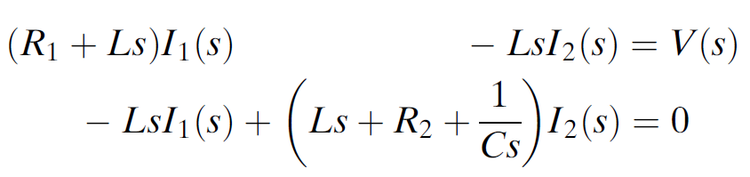
Electrical network transfer functions
Rearranging the above equations we get
We can solve this using Cramers’ rule:

Slide 39
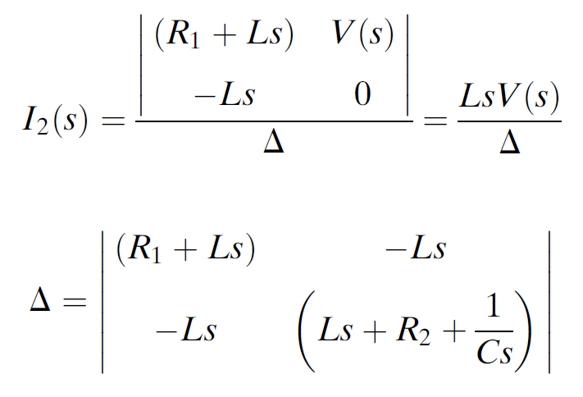
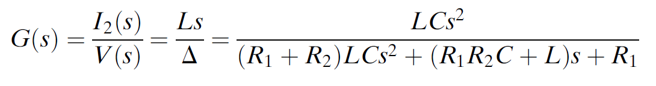
Electrical network transfer functions
Applying Cramers’ rule we get

Slide 40
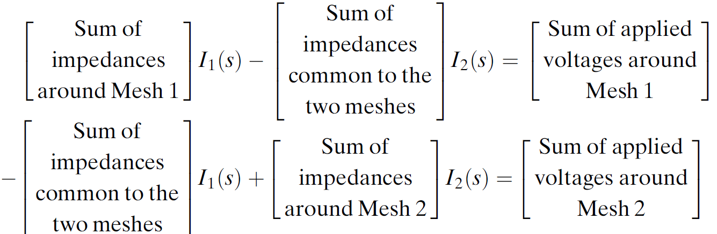
Electrical network transfer functions
They key for obtaining the transfer function is the ability to write the network equation
Let us apply a trick to write the mesh equations quickly (by inspection)

Slide 41
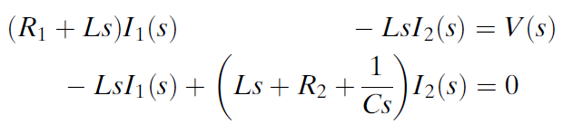
Electrical network transfer functions

Slide 42
Electrical network transfer functions
Let us solve a problem using the above method

Slide 43
Electrical network transfer functions

Slide 44
Translational mechanical system transfer functions
We can model mechanical systems using analogies with electrical networks.
Mechanical systems, like electrical systems can be modelled using three passive, linear components
the spring and the mass, are energy-storage elements like inductor and capacitor
the viscous damper, dissipates energy like resistance.

Slide 45
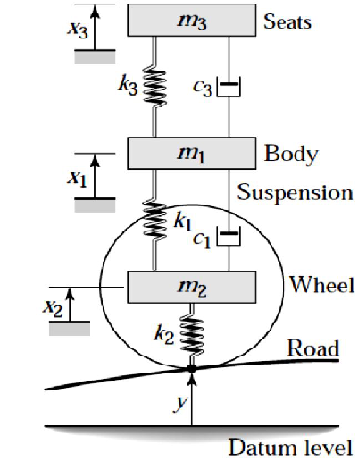
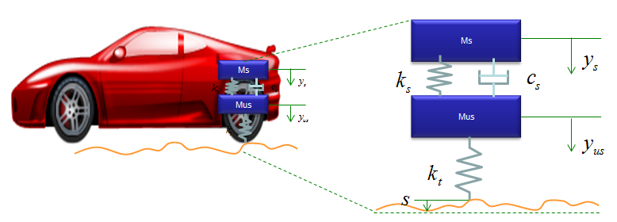
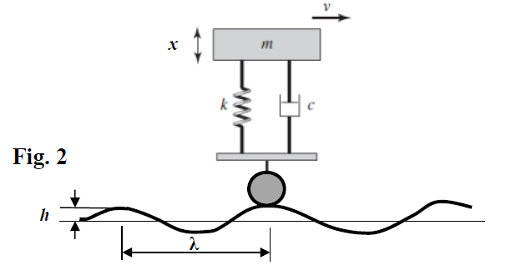
Translational mechanical system transfer functions
Let us take an example of a car suspension system

Slide 46
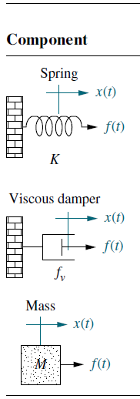
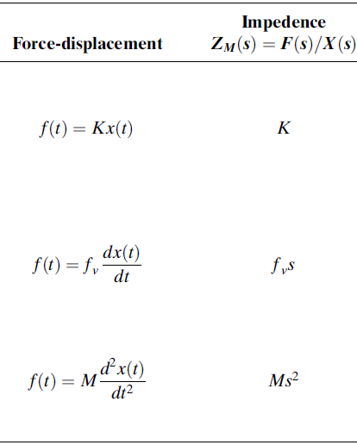
Translational mechanical system transfer functions

Slide 47
Translational mechanical system transfer functions
Just like we took the example of a simple RLC circuit we will take the example of simple translational mechanical system and write the equations of motion (Newton's second law)
We use the tool called “the free body diagram” to do this systematically

Slide 48
Translational mechanical system transfer functions
Find the transfer function, X(s)/F(s), for the system in the Figure:
Begin the solution by drawing the free-body diagram shown in Figure.
Place on the mass all forces felt by the mass.
The mass is traveling toward the right.
Thus, only the applied force points to the right; all other forces impede the motion and act to oppose it.
Hence, the spring, viscous damper, and the force due to inertia point to the left.
We now write the differential equation of motion using Newton's law to sum to zero all of the forces shown on the mass

Slide 49
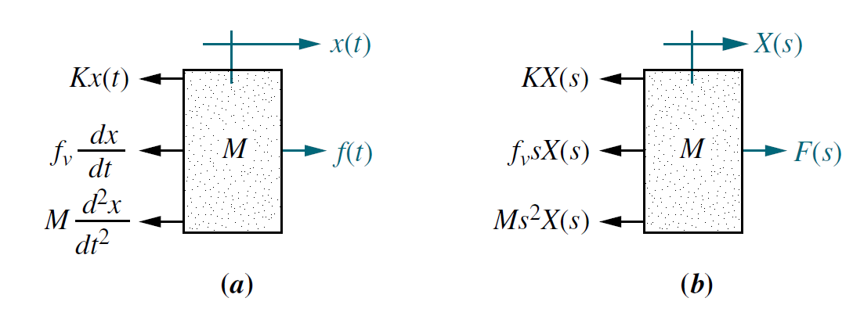
Translational mechanical system transfer functions
Taking the Laplace transform, assuming zero initial conditions:
Solving for the transfer function yields:
Here again to avoid the differentials and integrals we can use the impedance trick

Slide 50
Translational mechanical system transfer functions
The previous system was a mechanical system with one ‘degree of freedom’ (DOF). Let us see systems with more than one DOF. Like circuits with multiple meshes.
Can we find the transfer function X₂(s)/F(s) for.

Slide 51
Electrical network transfer functions

Slide 52
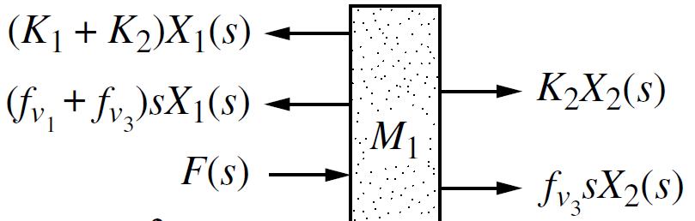
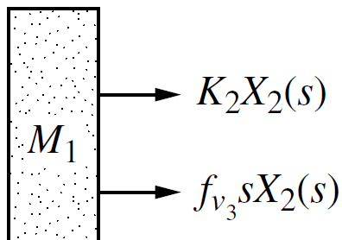
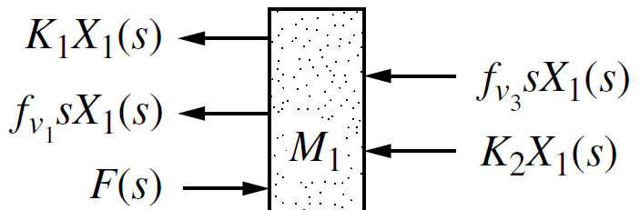
Translational mechanical system transfer functions

Slide 53
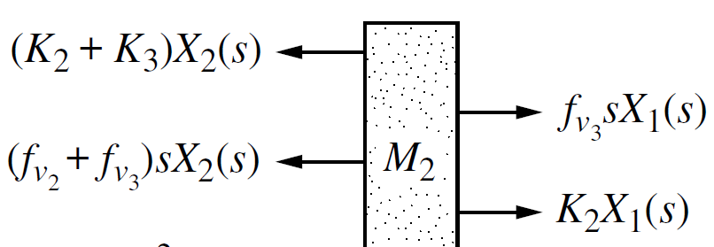
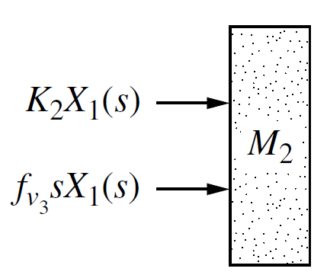
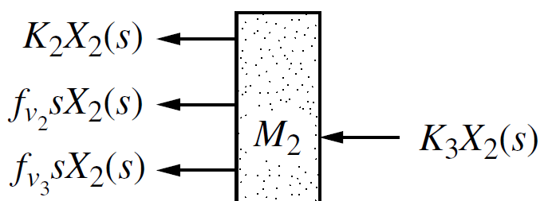
Translational mechanical system transfer functions

Slide 54
Translational mechanical system transfer functions

Slide 55
Translational mechanical system transfer functions

Slide 56
Translational mechanical system transfer functions
The final equations are.
Can we write them by inspection
From equations using cramer’s rule we can find the transfer function
X₂(s)/F(s)

Slide 57
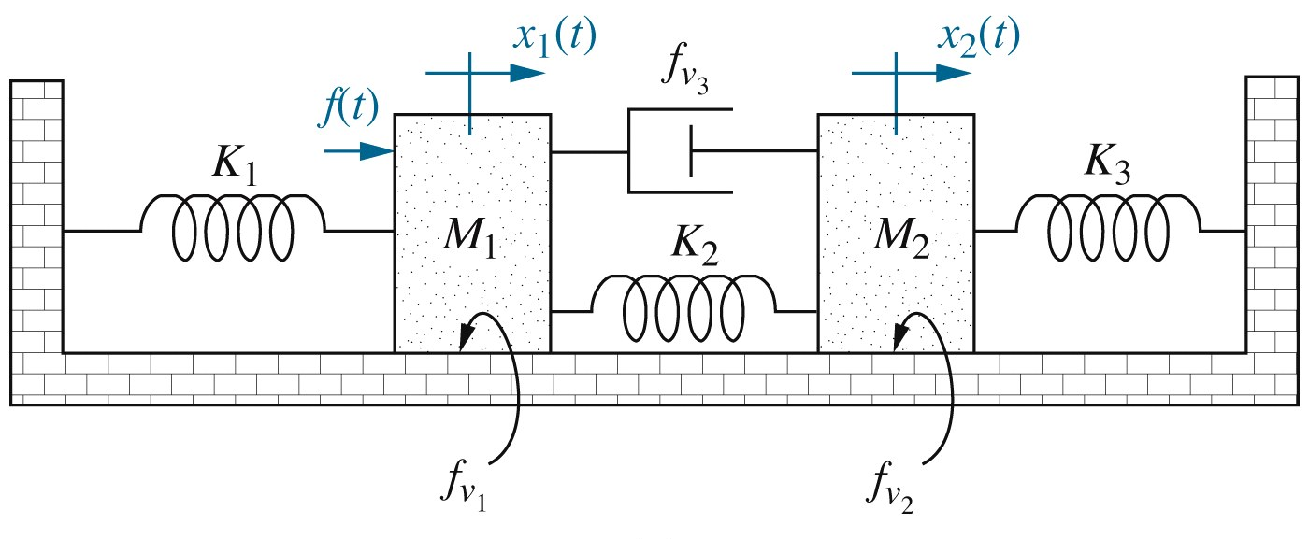
You can also do this just by inspection:

Slide 58
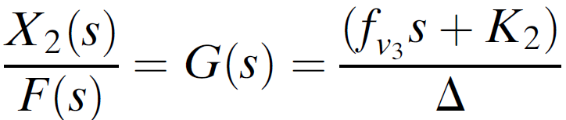
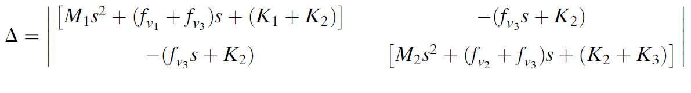
Translational mechanical system transfer functions

Slide 59
Translational mechanical system transfer functions
Let us write the equations of motion for this (by inspection)

Slide 60
Translational mechanical system transfer functions

Slide 61
Other topics
Other types of systems rotational, with gears, EM systems
Analogous systems
Nonlinearities
Linearization
Transfer function of a DC motor

